Slide 1
MQXC: magnetic design status and field table (no CS head)
F. Borgnolutti
P. Fessia
E. Todesco
11/12/08

Slide 2
Yoke lamination shape defect
Ellipticity of the collar coil cavity of +/- 0.1 mm
yoke shaped like an ellipse
 | x=-0.1 mm | x=+0.1 mm
Δb4 | -0.05 | 0.04
Δb6 | 0 | 0
Δb10 | 0 | 0
Δb14 | 0 | 0
Shift of the collar coil cavity respect to
center of collar coil
shift of the yoke
 | -0.1 in x | 0.1 in x | -0.1mm @ pi/4 |  | +0.1mm @ pi/4
 | Δbn | Δbn | Δbn | Δan | Δbn | Δan
3 | 0.46 | -0.46 | 0.33 | -0.33 | -0.33 | 0.33
4 | 0 | 0 | 0 | 0 | 0 | 0
5 | 0 | 0 | 0 | 0 | 0 | 0
 | min | max
Δb3 | -0.46 | 0.46
Δb4 | -0.05 | 0.04

Slide 3
Collar lamination: shape defect
(coil cavity)
x and y coils shift (radius is kept constant)
 | +50 um | -50 um
Δb6 | 0.45 | -0.45
Δb10 | -0.06 | 0.06
Δb14 | 0.02 | -0.01
collar radius +/-0.05mm
 | +50 um | -50 um
Δb6 | 0.63 | -0.63
Δb10 | 0.02 | -0.02
Δb14 | 0.00 | 0.00
 | min | max
Δb6 | -0.63 | 0.63
Δb10 | -0.06 | 0.06
Δb14 | -0.01 | 0.02

Slide 4
Copper wedges
Two parameters: the thickness of the edge and the angle of the side
the thickness of the collar nose is kept constant
copper wedges +/- 30 um az
 | cp1+/cp2 0 | cp1-/cp2 0 | cp1-/cp2- | cp1-/cp2+ | cp1 0/cp2+ | cp1 0/cp2- | cp1+/cp2- | cp1+/cp2+
Δb6 | 0.471 | -0.471 | -0.664 | -0.278 | 0.193 | -0.193 | 0.278 | 0.665
Δb10 | 0.052 | -0.051 | -0.060 | -0.043 | 0.009 | -0.009 | 0.043 | 0.060
Δb14 | -0.011 | 0.011 | 0.012 | 0.011 | 0.000 | 0.000 | -0.011 | -0.012
copper wedges +/- 30 um tilt
 | incp1-/cp20 | incp1+/cp20 | incp1+/cp2+ | incp1+/cp2- | incp1-/cp2- | incp-/cp2+ | incp10/cp2+ | incp10/cp2-
Δb6 | -0.003 | 0.009 | -0.004 | 0.022 | 0.010 | -0.016 | -0.013 | 0.013
Δb10 | -0.068 | 0.067 | 0.070 | 0.064 | -0.071 | -0.065 | 0.003 | -0.003
Δb14 | 0.014 | -0.015 | -0.015 | -0.014840 | 0.015 | 0.015 | 0.0 | 0.0
 | min | max
Δb6 | -0.68 | 0.687
Δb10 | -0.131 | 0.13
Δb14 | -0.026 | 0.026

Slide 5
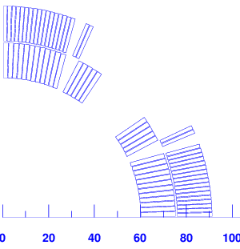
Imperfection in curing mould-> conductors misplaced
Polymerisation defect (radial displacement -50um)
 | block 2 |  | block 1 |  | block 1/2/3 |  | block 2/4
 | Δan | Δbn | Δan | Δbn | Δan | Δbn | Δan | Δbn
2 | -1.24 |  | -1.27 |  | -3.4 |  | -1.46
3 | 0 | 0 | 0 | 0 | 0 | 0 | 0 | 0
4 | 0 | 0.01 | 0 | 0.01 | 0 | 0.04 | 0 | 0.01
5 | 0 | 0 | 0 | 0 | 0 | 0 | 0 | 0
6 | 0.03 | -0.55 | -0.99 | 0.40 | -1.27 | 0.01 | 0.00 | -0.59
7 | 0 | 0 | 0 | 0 | 0 | 0 | 0 | 0
8 | 0 | 0 | 0 | 0 | 0 | 0 | 0 | 0
9 | 0 | 0 | 0 | 0 | 0 | 0 | 0 | 0
10 | 0.1 | 0.07 | -0.14 | -0.06 | -0.06 | 0.00 | 0.1 | 0.07
11 | 0 | 0 | 0 | 0 | 0 | 0 | 0 | 0
12 | 0 | 0 | 0 | 0 | 0 | 0 | 0 | 0
13 | 0 | 0 | 0 | 0 | 0 | 0 | 0 | 0
14 | -0.021 | 0.009 | -0.004 | -0.01 | -0.025 | 0 | -0.02 | 0.01
2
4
3
1
Considering a symmetric effect (defect on the left leg of the pole not the right)
 | min | max
Δb4 | -0.04 | 0.04
Δb6 | -0.6 | 06
Δb10 | -0.06 | 0.06
Δb14 | -0.01 | 0.01
 | min | max
Δa6 | -1.27 | 1.27
Δa10 | -0.1 | 0.1
Δa14 | -0.025 | 0.025

Slide 6
Collar steel permeability
(negligible, it can be compensated)
collar permeability (mur = 1.002)
 |  |  | Δbn
2 |  |  | 0
3 |  |  | 0
4 |  |  | -0.001
5 |  |  | 0
6 |  |  | 0.018
7 |  |  | 0
8 |  |  | 0
9 |  |  | 0
10 |  |  | -0.0004
11 |  |  | 0
12 |  |  | 0
13 |  |  | 0
14 |  |  | 0.0000
collar permeability (mur = 1.003)
 |  |  | Δbn
2 |  |  | 0
3 |  |  | 0
4 |  |  | -0.007
5 |  |  | 0
6 |  |  | 0.029
7 |  |  | 0
8 |  |  | 0
9 |  |  | 0
10 |  |  | -0.0005
11 |  |  | 0
12 |  |  | 0
13 |  |  | 0
14 |  |  | 0.0000

Slide 7
Estimation of deformation due to EM forces (60 µm)
(it can be compensated)
ellipticity of the collar (+60 um at the mid-plane)
n |  |  | Δbn
2
3 |  |  | 0
4 |  |  | 0
5 |  |  | 0
6 |  |  | 0.34
7 |  |  | 0
8 |  |  | 0
9 |  |  | 0
10 |  |  | 0.05
11 |  |  | 0
12 |  |  | 0
13 |  |  | 0
14 |  |  | -0.002

Slide 8
Layer jump and splice

Slide 9
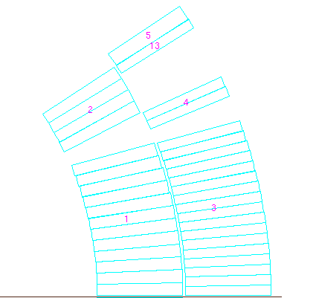
Peak field and field quality in layer jump, real yoke
 | staight part | 3.7 mm | 7.46mm | 15.87 mm | 15.87 mm
 | cable in | pos 1/4 | cable midle | cable out | splice
Bp1 (T) | 7.14 | 7.17 | 7.19 | 7.21 | 7.21
Bp2 | 7.43 | 7.69 | 7.76 | 7.78 | 7.79
Bp3 | 6.26 | 6.24 | 6.24 | 6.26 | 6.25
Bp4 | 6.62 | 6.59 | 6.55 | 6.55 | 6.53
Bp5 | 7.89 | 7.90 | 7.81 | 6.82 | 6.86
Bp13 | 6.63 | 6.35 | 6.28 | 6.42 | 6.66
G (T/m) | 118.50 | 118.42 | 118.35 | 118.23 | 118.27
b6 | -0.01 | 6.26 | 10.61 | 16.28 | 16.09
b10 | -0.04 | -1.44 | -2.22 | -2.97 | -2.99
b14 | -0.08 | 0.06 | 0.12 | 0.17 | 0.17
a2 | 0.00 | 16.78 | 30.99 | 55.49 | 57.00
a6 | 0.00 | -2.99 | -5.06 | -7.77 | -8.28
a10 | 0.00 | -0.44 | -0.68 | -0.92 | -0.87
a14 | 0.00 | 0.24 | 0.35 | 0.42 | 0.42
lmag | straight | 100 mm | 140 mm
We can consider an equivalent magnetic length of 240 mm and as perturbation we can
consider a radial offset of the splice cable pair of +/-0.1mm

Slide 10
Field quality uncertainty
 | splice (240mm)
 |  | 0.1mm rad
n | <bn> | Δbn | Δbn
2 |  | + | -
3 | 0 | 0 | 0
4 | 0 | 0 | 0
5 | 0 | 0 | 0
6 | 16 | 0.05 | -0.05
7 | 0 | 0 | 0
8 | 0 | 0 | 0
9 | 0 | 0 | 0
10 | -3 | 0.00 | 0.00
11 | 0 | 0 | 0
12 | 0 | 0 | 0
13 | 0 | 0 | 0
14 | 0.17 | 0.00 | 0.00
 | <an> | Δan | Δan
3 | 0 | 0 | 0
4 | 0 | 0 | 0
5 | 0 | 0 | 0
6 | -8.3 | -0.02 | 0.02
7 | 0 | 0 | 0
8 | 0 | 0 | 0
9 | 0 | 0 | 0
10 | -0.9 | 0.00 | 0.00
11 | 0 | 0 | 0
12 | 0 | 0 | 0
13 | 0 | 0 | 0
14 | 0.4 | 0.00 | 0.00
We can neglect this effect for straight part as long as
7 meters as we interested here

Slide 11
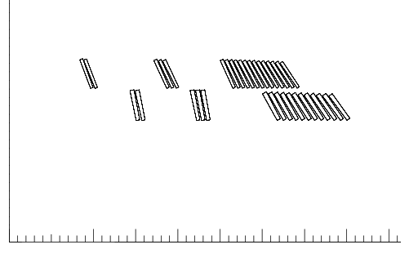
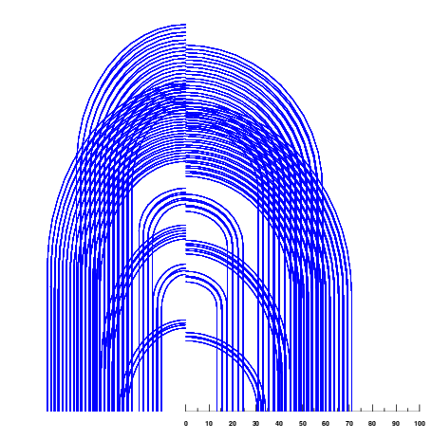
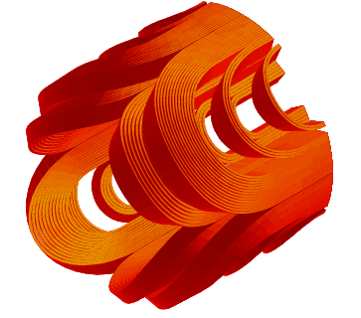
NCS head design

Slide 12
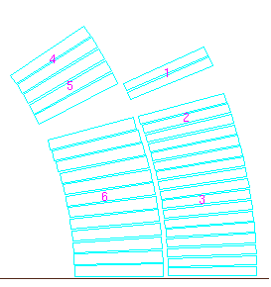
Peak field in the head,
30 mm of coil more and a lot more of margin in the head
 |  | straight part |  | head | B peak | ss field | % ss cur
no Iron Yoke | cable 01 | BS1 | 6.5 | 6.6 | cb01
 |  | BS2 | 7.3 | 7.4 | 7.4 | 9.6 | 77
 | cable 02 | BS3 | 5.7 | 6.1 | cb02
 |  | BS4 | 6.1 | 6.4 | 6.4 | 8.4 | 75
unsat Yoke | cable 01 | BS1 | 7.3 | 7.3 | cb01
 |  | BS2 | 8.1 | 8.1 | 8.1 | 9.9 | 82
 | cable 02 | BS3 | 6.4 | 6.7 | cb02
 |  | BS4 | 6.8 | 7.2 | 7.2 | 8.8 | 82
real Yoke | cable 01 | BS1 | 7.1 | 7.2 | cb01
 |  | BS2 | 7.9 | 8.0 | 8.00 | 9.8 | 81
 | cable 02 | BS3 | 6.6 | 6.6 | cb02
 |  | BS4 | 6.6 | 7.0 | 7.03 | 8.7 | 81
2
4
1
no yoke | unsat yoke | real iron
Lmag | 104 | 117 | 116
b6 | -2.9 | -2.8 | -2.8
b10 | -4.0 | -3.8 | -3.6
b14 | -0.3 | -0.4 | -0.3
Uncertainty: systematic coil length error 3 mm-> shift between heads->+/-0.9 Δb6
Random: variation coil length 1σ 2mm-> shift between heads->+/-0.6 Δb6
This gives an uncertainty of +/- 0.03 for a straight part of 7000 mm and a random of 0.02.
We will neglect it

Slide 14
Geometric value
multipoles | straight part | layer jump | heads | total magnet
 | length of straight part [mm] | length of layer jump [mm] | length of 1 head | total magnetic length
 | 7250 | 240 | 116 | 7722
b3 | 0 | 0 | 0 | 0.00
b4 | 0 | 0 | 0 | 0.00
b5 | 0 | 0 | 0 | 0.00
b6 | 0.01 | 16 | -2.8 | 0.42
b7 | 0 | 0 | 0 | 0.00
b8 | 0 | 0 | 0 | 0.00
b9 | 0 | 0 | 0 | 0.00
b10 | -0.035 | -3 | -3.6 | -0.23
b11 | 0 | 0 | 0 | 0.00
b12 | 0 | 0 | 0 | 0.00
b13 | 0 | 0 | 0 | 0.00
b14 | -0.075 | 0.17 | -0.3 | -0.07
a3 | 0 | 0 | 0 | 0.00
a4 | 0 | 0 | 0 | 0.00
a5 | 0 | 0 | 0 | 0.00
a6 | 0 | -8.3 | 0 | -0.26
a7 | 0 | 0 | 0 | 0.00
a8 | 0 | 0 | 0 | 0.00
a9 | 0 | 0 | 0 | 0.00
a10 | 0 | -0.9 | 0 | -0.03
a11 | 0 | 0 | 0 | 0.00
a12 | 0 | 0 | 0 | 0.00
a13 | 0 | 0 | 0 | 0.00
a14 | 0 | 0.4 | 0 | 0.01
multipoles | straight part | layer jump | heads | total magnet
 | length of straight part [mm] | length of layer jump [mm] | length of 1 head | total magnetic length
 | 9500 | 240 | 116 | 9972
b3 | 0 | 0 | 0 | 0.00
b4 | 0 | 0 | 0 | 0.00
b5 | 0 | 0 | 0 | 0.00
b6 | 0.01 | 16 | -2.8 | 0.33
b7 | 0 | 0 | 0 | 0.00
b8 | 0 | 0 | 0 | 0.00
b9 | 0 | 0 | 0 | 0.00
b10 | -0.035 | -3 | -3.6 | -0.19
b11 | 0 | 0 | 0 | 0.00
b12 | 0 | 0 | 0 | 0.00
b13 | 0 | 0 | 0 | 0.00
b14 | -0.075 | 0.17 | -0.3 | -0.07
a3 | 0 | 0 | 0 | 0.00
a4 | 0 | 0 | 0 | 0.00
a5 | 0 | 0 | 0 | 0.00
a6 | 0 | -8.3 | 0 | -0.20
a7 | 0 | 0 | 0 | 0.00
a8 | 0 | 0 | 0 | 0.00
a9 | 0 | 0 | 0 | 0.00
a10 | 0 | -0.9 | 0 | -0.02
a11 | 0 | 0 | 0 | 0.00
a12 | 0 | 0 | 0 | 0.00
a13 | 0 | 0 | 0 | 0.00
a14 | 0 | 0.4 | 0 | 0.01

Slide 15
Uncertainty straight part
 | defect of yoke lamination |  | defect of collar lamination |  | defect of copper wedges |  | defect of curing mould |  | EM forces deformation |  | total |  | total sum of square
 | min | max | min | max | min | max | min | max | min | max | min | max | min | max
Δb3 | -0.46 | 0.46 |  |  |  |  |  |  |  |  | -0.46 | 0.46 | -0.46 | 0.46
Δb4 | -0.05 | 0.04 |  |  |  |  | -0.04 | 0.04 |  |  | -0.09 | 0.08 | -0.06 | 0.06
Δb5 |  |  |  |  |  |  |  |  |  |  | 0 | 0 | 0 | 0
Δb6 |  |  | -0.45 | 0.45 | -0.68 | 0.68 | -0.6 | 0.6 |  | 0.34 | -1.73 | 2.07 | -1.01 | 1.07
Δb7 |  |  |  |  |  |  |  |  |  |  | 0 | 0 | 0 | 0
Δb8 |  |  |  |  |  |  |  |  |  |  | 0 | 0 | 0 | 0
Δb9 |  |  |  |  |  |  |  |  |  |  | 0 | 0 | 0 | 0
Δb10 |  |  | -0.06 | 0.06 | -0.13 | 0.13 | -0.06 | 0.06 |  | 0.05 | -0.25 | 0.3 | -0.16 | 0.16
Δb11 |  |  |  |  |  |  |  |  |  |  | 0 | 0 | 0 | 0
Δb12 |  |  |  |  |  |  |  |  |  |  | 0 | 0 | 0 | 0
Δb13 |  |  |  |  |  |  |  |  |  |  | 0 | 0 | 0 | 0
Δb14 |  |  | -0.01 | 0.02 | -0.026 | 0.026 | -0.01 | 0.01 |  | -0.002 | -0.046 | 0.054 | -0.03 | 0.03
Δa3 |  |  |  |  |  |  |  |  |  |  | 0 | 0 | 0 | 0
Δa4 |  |  |  |  |  |  |  |  |  |  | 0 | 0 | 0 | 0
Δa5 |  |  |  |  |  |  |  |  |  |  | 0 | 0 | 0 | 0
Δa6 |  |  |  |  |  |  | -1.27 | 1.27 |  |  | -1.27 | 1.27 | -1.27 | 1.27
Δa7 |  |  |  |  |  |  |  |  |  |  | 0 | 0 | 0 | 0
Δa8 |  |  |  |  |  |  |  |  |  |  | 0 | 0 | 0 | 0
Δa9 |  |  |  |  |  |  |  |  |  |  | 0 | 0 | 0 | 0
Δa10 |  |  |  |  |  |  | -0.1 | 0.1 |  |  | -0.1 | 0.1 | -0.10 | 0.10
Δa11 |  |  |  |  |  |  |  |  |  |  | 0 | 0 | 0 | 0
Δa12 |  |  |  |  |  |  |  |  |  |  | 0 | 0 | 0 | 0
Δa13 |  |  |  |  |  |  |  |  |  |  | 0 | 0 | 0 | 0
Δa14 |  |  |  |  |  |  | -0.025 | 0.025 |  |  | -0.025 | 0.025 | -0.03 | 0.03

Slide 16
Summary
Straight part length 7250 mm magnetic length 7722 mm
 | geometric | uncertainity |  | random 1 sigma
 |  | min | max
b3 |  | -0.46 | 0.46 | 0.89
b4 | 0.00 | -0.06 | 0.06 | 0.64
b5 |  |  |  | 0.46
b6 | 0.42 | -1.01 | 1.07 | 1.28
b7 |  |  |  | 0.21
b8 |  |  |  | 0.16
b9 |  |  |  | 0.08
b10 | -0.23 | -0.16 | 0.16 | 0.06
b11 |  |  |  | 0.03
b12 |  |  |  | 0.02
b13 |  |  |  | 0.01
b14 | -0.07 | -0.03 | 0.03 | 0.01
a3 |  |  |  | 0.89
a4 |  |  |  | 0.64
a5 |  |  |  | 0.46
a6 | -0.26 | -1.27 | 1.27 | 0.33
a7 |  |  |  | 0.21
a8 |  |  |  | 0.16
a9 |  |  |  | 0.08
a10 | -0.03 | -0.10 | 0.10 | 0.06
a11 |  |  |  | 0.03
a12 |  |  |  | 0.02
a13 |  |  |  | 0.01
a14 | 0.01 | -0.03 | 0.03 | 0.01

